Slide 1
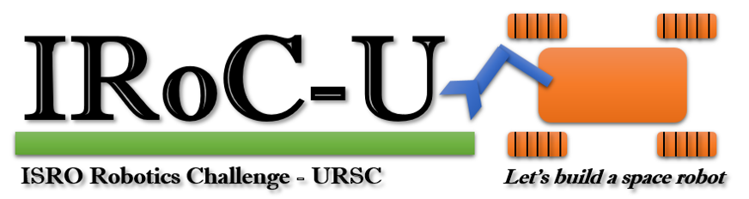

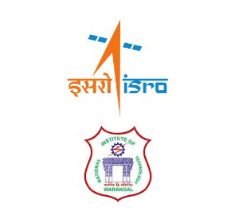
TEAM
LUNARATH

Slide 2
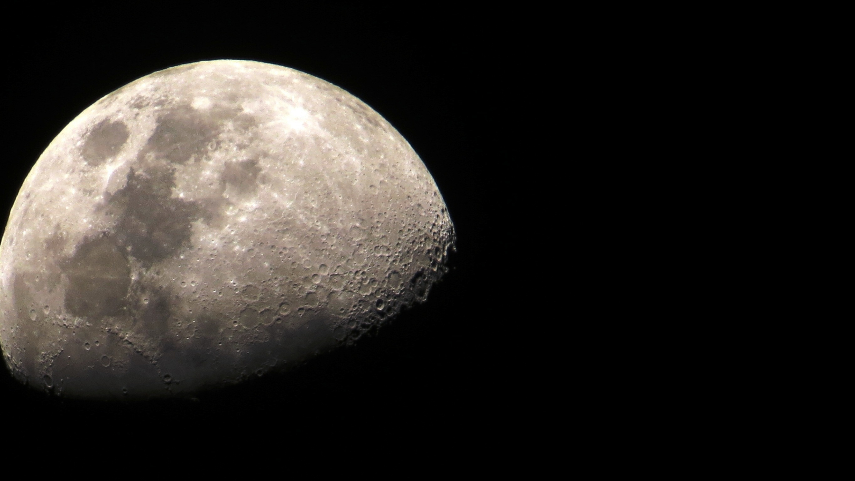
COMPETION DETAILS
OUR TEAM
Objectives of the Challenge
It enhances their communication, collaboration, inquiry, problem solving and flexibility skills that will benefit them in their academic and professional lives.
Co-develop (students and ISRO) future technologies needed in the area of space robotics.
Selection Process
Prelims Round: Registration and Submission of Proposal Report and presentation. (15th Jan)
Quals Round: Submission of Design Report and Demonstration of Prototype operation on the specified arena. ( 15th May)
Field Round: The final onsite competition to perform the required tasks is planned to be conducted at URSC Bengaluru. (5th Aug)

Slide 3

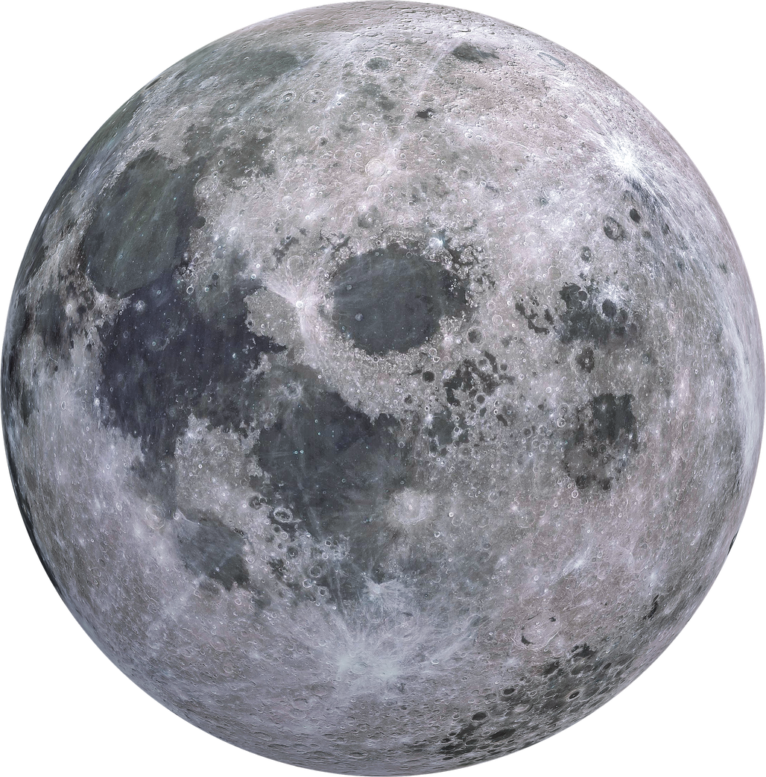
ARENA & TASK DETAILS
Navigation Task
Rover waypoint navigation in commanded and autonomous mode.
Obstacle identification using sensors.
Obstacle avoidance/traversal by mobility system.
Crater identification using sensors.
Crater avoidance/traversal by mobility system.
Sample Picking Task
Target identification using visual sensors.
Picking and loading on the rover chassis.
Target location identification.
Unloading and placement.
Final Parking.

Slide 4
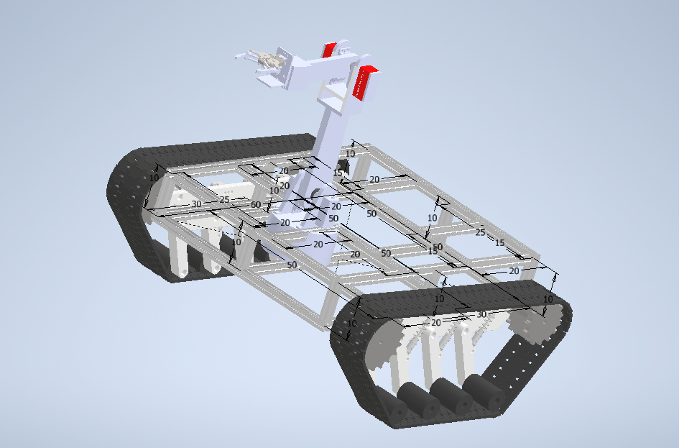
INNOVATION & NOVELTY
Roving Mechanism: Hybrid model is developed to meet the terrain requirements. Model is designed to run at optimum power consumption and better mobility.
Body Design The body designs are made is such a way that robotic arm will going to merge itself on the rover body making it a box shape rover body. At the time of operation, it will emerge through the body and after completion it get back to its starting position

Slide 5
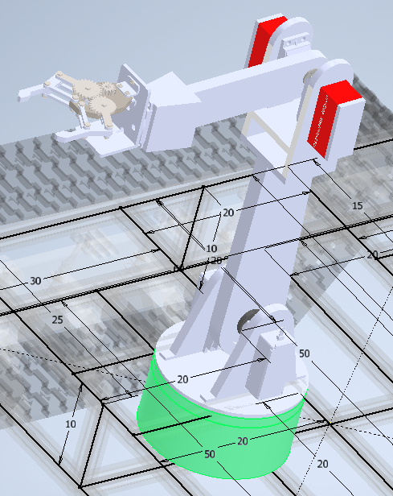
MECHANISM
Roving Mechanism
The use of hybrid mechanism consists of continuous tracks at the rear part and supporting wheels at the front.
The power is delivered by the separate DC motors to idler and wheel for smooth navigation controlled by PID mechanism.
Robotic Arm
Degree of freedom: 4
Material of construction will be a 3D printed (PLA)lightweight material with higher strength.
The Gripper structure is based on Gear-and-Rack Actuation which will be functional by the movement of attached servo motor which provides an optimum working field of view (FOV)

Slide 6

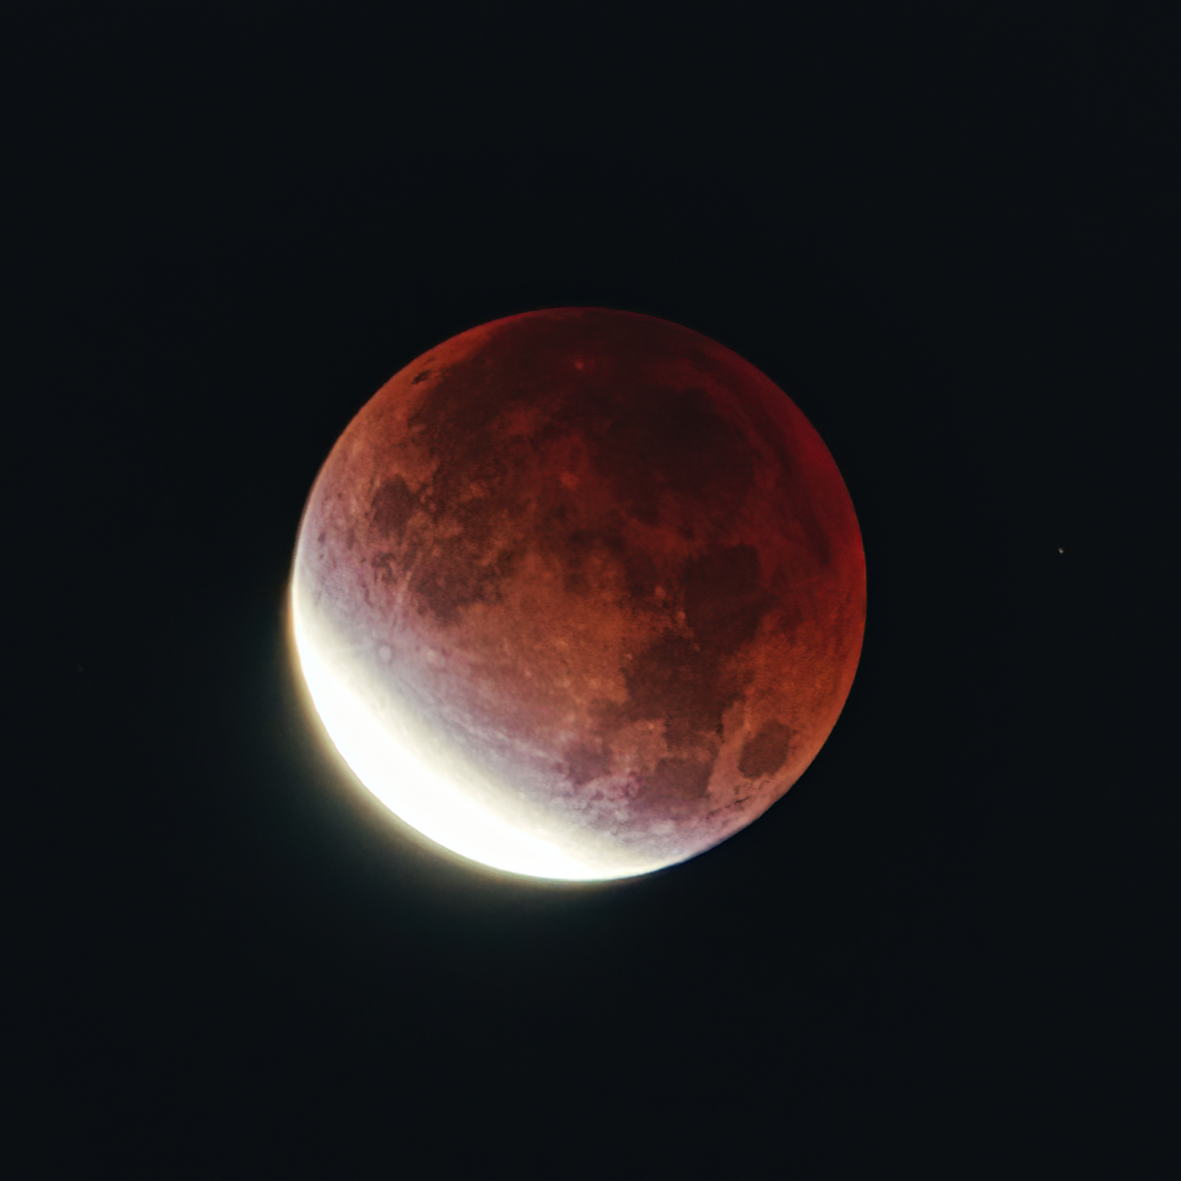
Our rover is equipped with advanced technologies, including depth cameras, stereo cameras and sensor integration using extended Kalman filter algorithm and some ROS2 software for roving mechanisms.
These processes are handled by a Jetson, making decisions about the rover's movement. Information is then sent to a Raspberry Pi, which, in turn, communicates with four motor drivers to control the rover's motion.
The rover is smart enough to avoid 30 cm cubes and 20cm obstacles while safely traversing over 15 cm cubes and 10cm craters. Upon reaching a specific waypoint (WP) region, the rover, guided by stereo cameras, stops near sample.
HARDWARE AND SOFTWARE REALIZATION PLAN
It instructs a webcam on the gripper to search for the red cylinder using OpenCV. If found, a robotic arm lifts the cylinder and places it on the rover before resuming movement. Additionally, the rover utilises PID control for efficient climbing on inclines. It searches for a blue cylinder using stereo cameras, stops when found, and places a red sample into the blue cylinder using a gripper-mounted webcam with help of Inverse Kinematics.

Slide 7

Total Rs 4.5 Lakhs Budget
Cassi degin and manufacturing : Rs 55,000
Onboard Sensors : Rs 92,050
BUDGET SEGMENTATION
Main Controlling Unit & Power System : Rs 1,03,400
Robotic Arm : Rs 70,000
Supporting Unit : Rs 1,29,000

Slide 8
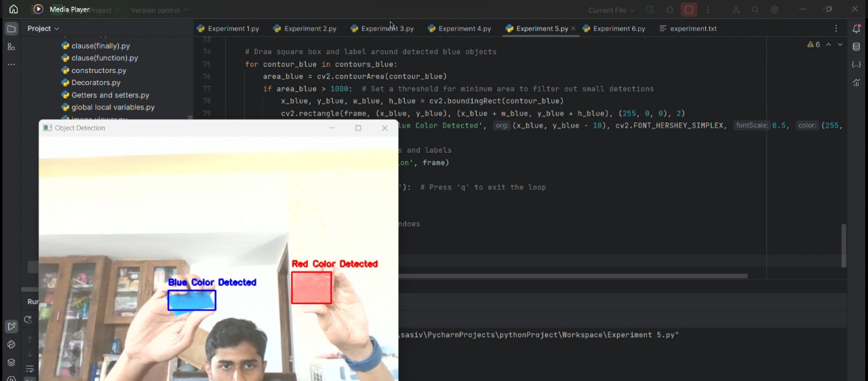
PROJECT STATUS
The CAD model of the chassi and robotic arm is in progress.
We finalied the frameworks and algorithms to operate the rover.
The test plan for the prototype in ready.
An emergency response system is also added for safety purposes.
We tested some of the algorithms like shape & colour detection using camera, crater and depth detection using computer vision and image processing.

Slide 9
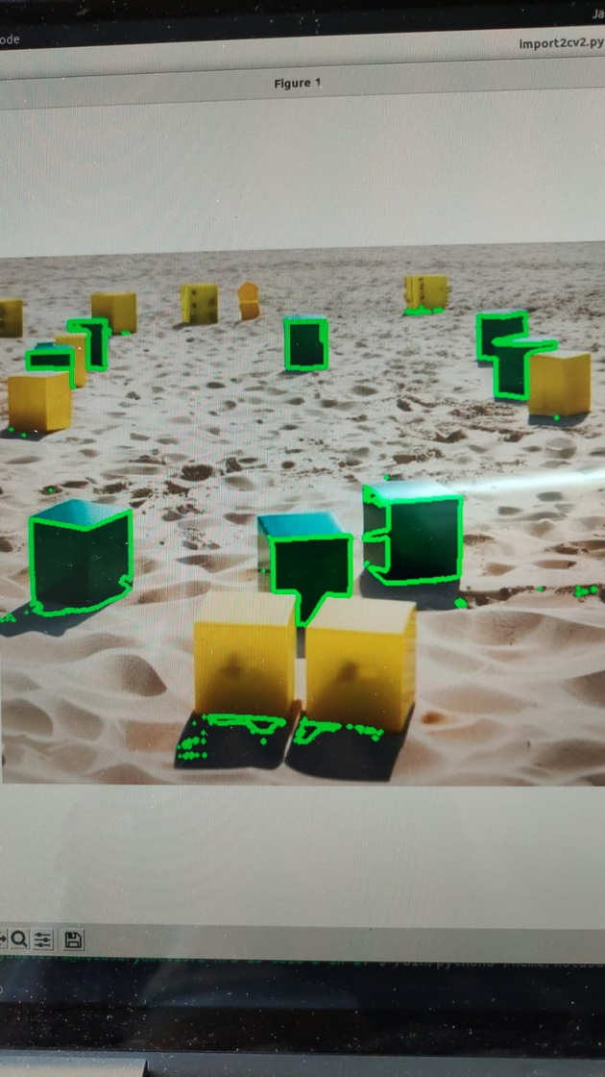
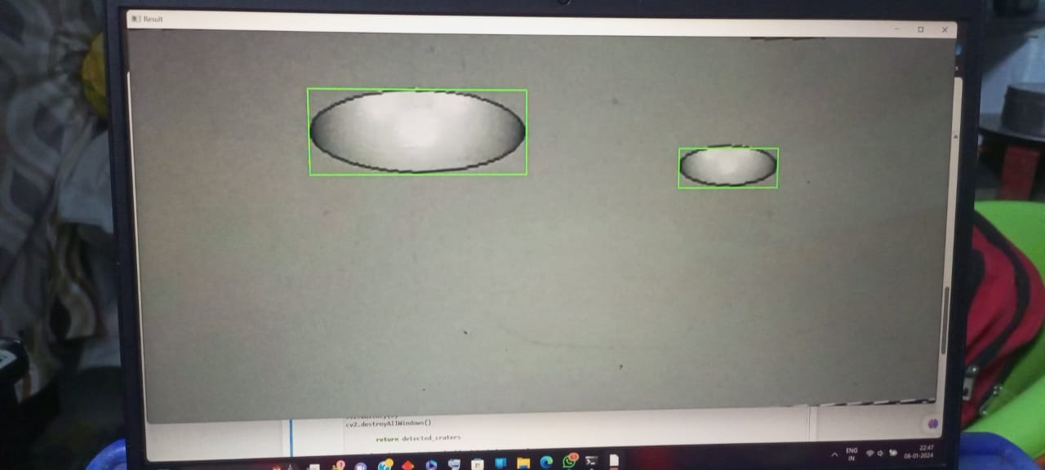
TESTING OBJECT DETECTION FOR NAVIGATION
Crater Detection
Colored Cube Detection

Slide 10

THANK YOU

Slide 11
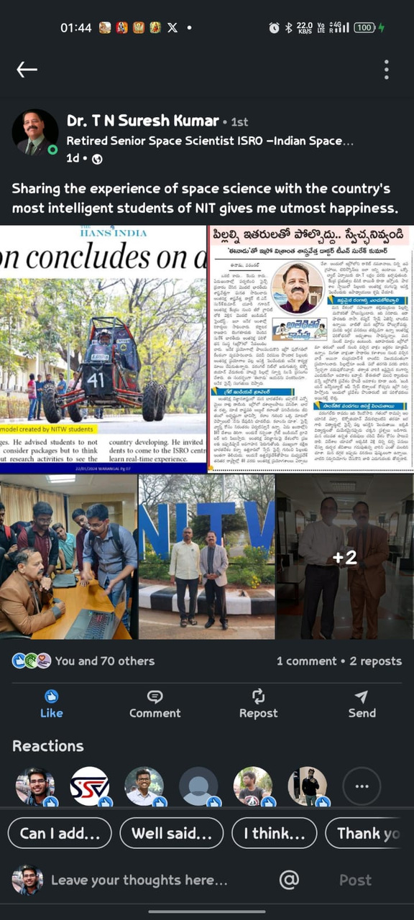
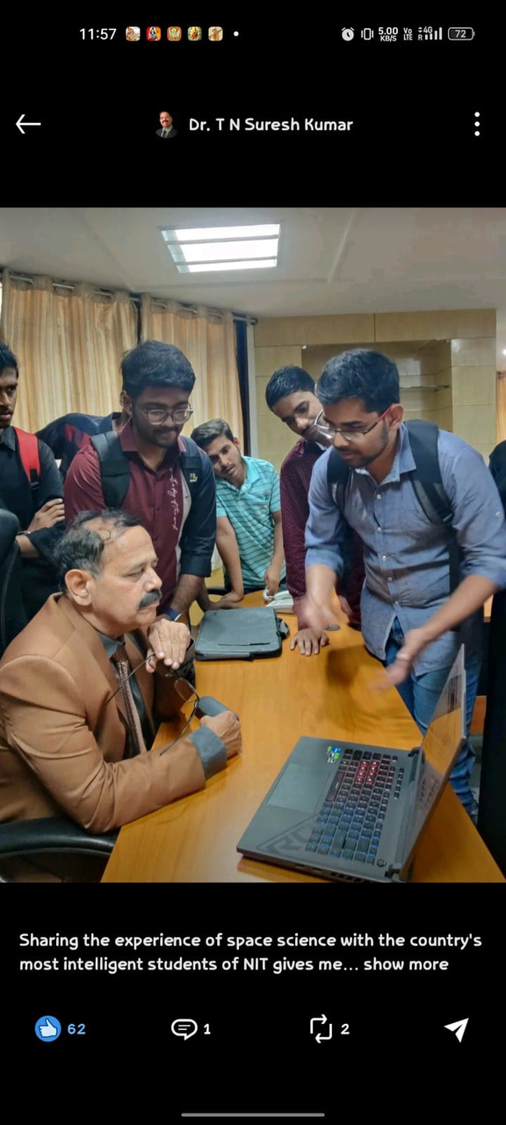
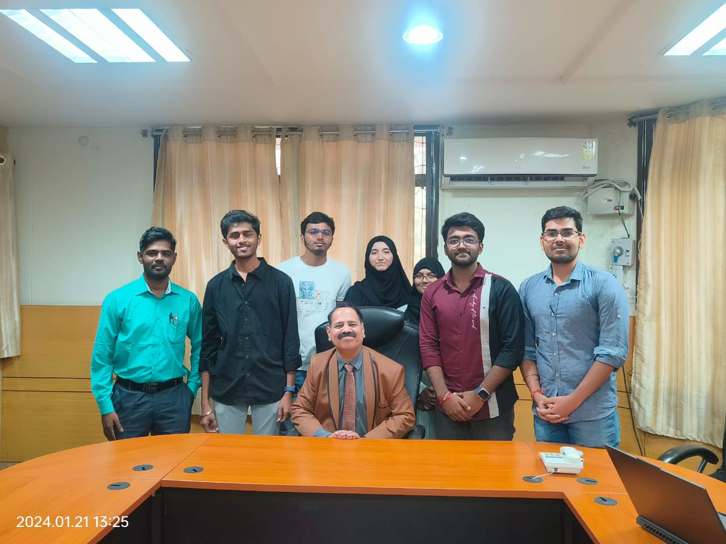
REVIEWS

